Slide 1
Open Data Principles
Report Update
22 November 2024

Slide 2
Stakeholder Engagements
Category | Organisation Name | Progress to date
Involved /Consulted / Informed | Municipalities | Primary Metro List eThekwini Metro – City of Durban City of Cape Town Metro– IKM Office Western Cape Province – Provincial Data Office: Data Governance, Policy and Legislation City of Johannesburg Metro– IKM - Smart City Office Secondary List City of Ekurhuleni Metro City of Tshwane Metro Enterprise Data Architecture Framework Cape Winelands District Garden Route District Makana Municipality – Kagiso Trust Sarah Baartman District Nelson Mandela Bay Metro (ECDC) Buffalo City Metro (ECDC) NGOs Kagiso Trust Open Cities Lab GIZ (Germany) FCDO (British High Commission) Open Data Institute (UK)

Slide 3
City of Joburg
Use Case: Safety and Services Provisioning
CCTV data to be utilised for Safety and Services
CoJ to be used as an example Use Case for other Municipalities

Slide 4
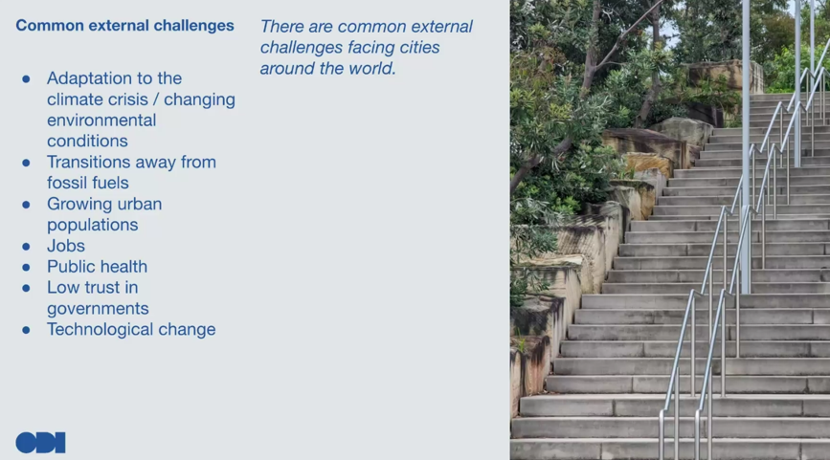
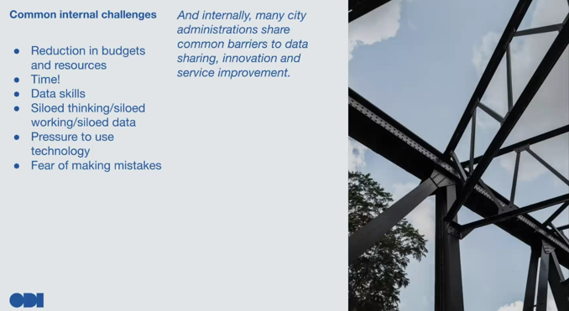
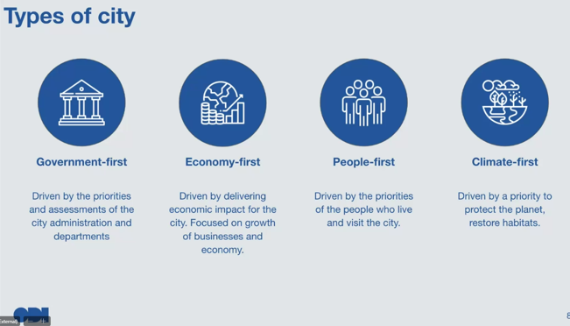
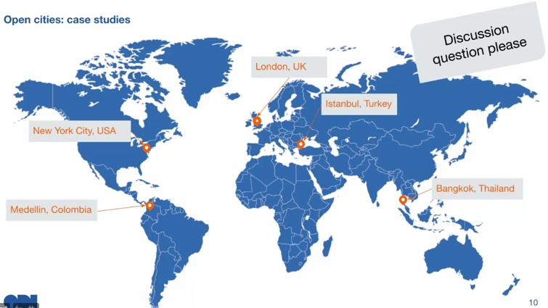
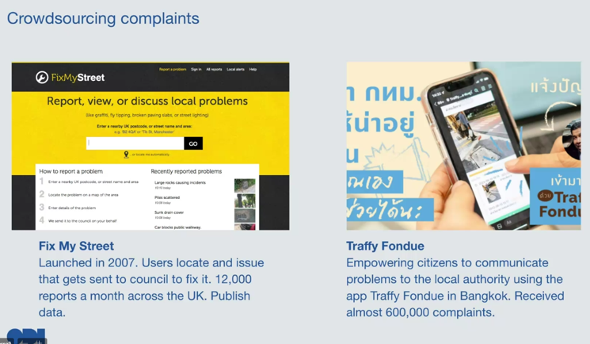
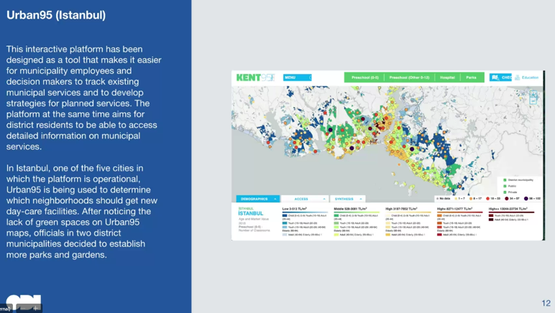
eThekwini
on-line Teams workshop Data Strategy – Community Practice held on 27 August 2024
eThekwini and Open Cities Lab
Open Data Institute (ODI) – Ben Snaith from UK
further development and deployment of Open Data within their departments.
Eg of Open Data utilization to provide better services in UK (London) and Bangkok

Slide 5
Cape Winelands District
Initiated multiple sessions with the 20 district municipal departments and we are now finalizing the Data Governance report with recommendations:
    06 March 2024: Project, Transport, Roads, ICT, Maintenance
    14 March: SED, Transport, MHS
    12 March: Disaster Mngt, Fire Services, Spatial Planning
    08 May: Administration, Sport
    27 June: SCM, BTO, Communication
    28 June: IDP, Performance & Risk Management, HR
    11 September: BTO

Slide 6
Thank you

